Slide 1
IELTS SPEAKING
Part 1
4 – 5 minutes
11 – 14
minutes
3 – 4 minutes
(1 minute preparation)
Part 2
Part 3
4 – 5 minutes

Slide 2
STRUCTURE
Part 1: Introduction and Interview |  | 4-5 minutes
Part 2: Individual long turn |  | 3-4 minutes (including 1 minute preparation time)
Part 3: Two-way discussion |  | 4-5 minutes
Examiner introduces him/herself and checks your name.
The examiner then asks you questions on general topics.
Examiner gives you a written task card. You have 1 minute to think (take notes) before you have to speak for 1–2 minutes.
Examiner asks one or two questions at the end of your talk.
Discuss with the examiner more abstract issues and concepts which are thematically linked to the topic of your talk in Part 2.

Slide 3
PART 1
Last for 4 – 5 minutes
Usually have 2-3 topics
Each topic usually has 3-4 questions
You should answer each question from 2 to 3 sentences.
Countryside
Walking
Number
Music
Patience
Hometown
Languages
Photos
Market
Haircut
Voice
Laugh
Animals
Friends
Travel

Slide 4
PART 1 SAMPLE
FRIENDS
What kinds of people do you like to make friends with?
Do you think you are a good friend for others?
What do you think makes good friends?
Do you keep in contact with friends from your childhood?

Slide 5
PART 2
Last for 3 – 4 minutes
You are given a paper and a pen to prepare for 1 minute
Each topic has 4 leading questions that you should cover in the speech
You can say other points relating to the topic
Don’t speak off topic
Speak for 2 minutes.
Describe a practical skill you learned.
Describe a photograph you like in your room.
Describe a film you would like to share with your friends.
Describe an occasion when you met someone for the first time.

Slide 6
PART 2 SAMPLE
SPECIAL DAY
Describe a special day that you remember well.
You should say:
Where you were
Who you were with
What you did
Explain why you remember it well

Slide 7
PART 3
Last for 4 – 5 minutes
The questions are connected to the topic in part 2
The questions are much less personal and more general
The questions are relatively easy at the start and then get more difficult

Slide 8
PART 3 SAMPLE
SPECIAL DAY
Do people spend too much money on their birthday parties or weddings?
How much do you think people should spend on their birthday parties or weddings?
Which is the better way to retain memories, by videos or photos?
How can forgetful people remember things better?

Slide 9
RECALLING QUESTIONS
Which part (one, two, or three) gives preparation time before you give your answer?
Which part is like a conversation with the examiner?
Which part requires you to speak about a general, abstract topic rather than personal topic?
Which part focuses on every day’s topic?
Which part requires you to talk for a few minutes on a single topic relating to your own experience?

Slide 10
CRITERIA
Fluency & Coherence
Lexical Resource
Grammatical Range & Accuracy
Pronunciation

Slide 11
FLUENCY
Talking at length
Talking without self-correction
Talking without pauses or hesitations
Fluency
Able to be understood
Using linking devices

Slide 12
LEXICAL RESOURCE
Using a range of words & Paraphrasing
Using collocations
Lexical
Resource
Using less common vocabulary
Avoiding errors

Slide 13
GRAMMATICAL RANGE &
ACCURACY
Using a range of sentence structures
Grammatical range & Accuracy
Using a range of grammar tenses
Avoiding errors

Slide 14
PRONUNCIATION
Able to be understood throughout the test
Able to use intonation
Accent doesn’t affect understanding
Accurate word and sound pronunciation

Slide 15
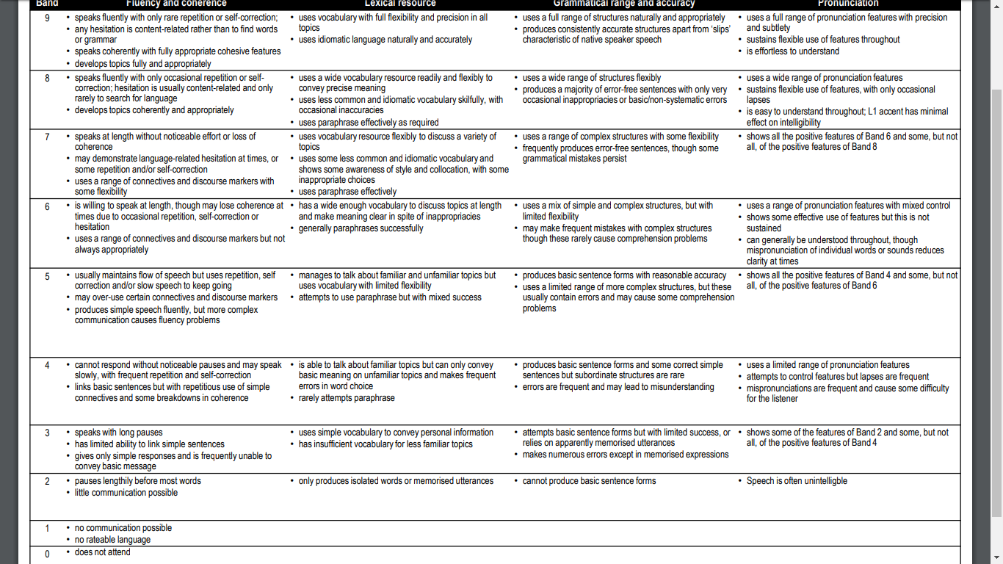
DESCRIPTORS

Slide 16
DESCRIPTORS

Slide 17


Slide 18
Feelings & Opinions
1. Where do you like to travel?
Short answer: I like to travel to the beach.
Long answer: I like to travel to the beach because I love relaxing by the sea, and it always makes me feel calm and refreshed.

Slide 19
Contrasting ideas
2. Do you prefer traveling alone or with friends?
Short answer: I prefer traveling with friends.
Long answer: I prefer traveling with friends because it’s more fun, but sometimes I enjoy going alone to have some peace and quiet.

Slide 20
Combining ideas
3. What’s your favorite means of transport when travel?
Short answer: I like traveling by train.
Long answer: I like traveling by train because it’s comfortable, and I can enjoy the beautiful scenery along the way. It’s also more relaxing than driving.

Slide 21
Past comparisons
4. Have your travel habits changed over time?
Short answer: Yes, they’ve changed a lot.
Long answer: Yes, they’ve changed a lot. I used to prefer short trips near my city, but now I enjoy longer trips to different countries when I have time.

Slide 22
Adding reasons
5. Do you like visiting big cities?
Short answer: Yes, I always do.
Long answer: Yes, I always do because I can explore a lot of interesting places and try many exciting activities there.

Slide 23
Future
6. Do you like travelling abroad?
Short answer: Yes, I love visiting other countries.
Long answer: Yes, I love visiting other countries. Actually, I’m planning a trip to Japan next summer. I want to visit Tokyo and Kyoto to experience the culture and try the local food.

Slide 24
Giving examples
7. What kind of places do you like to visit?
Short answer: I like visiting historical sites.
Long answer: I like visiting historical sites, for example, last year I went to the ancient city of Hoi An, and it was amazing to see the old buildings and learn about the history there.

Slide 25
Frequency
8. When do you usually travel?
Short answer: I travel a few times during summer and winter.
Long answer: I usually travel a few times a year, mostly during the summer and winter holidays. However, sometimes I also take short weekend trips when I feel like I need a break.

Slide 26
EXPANDING IDEAS
Feelings & Opinions
Contrasting Ideas
Combining Details
Past Comparisons
Adding Reasons
Future
Giving Examples
Frequency

